Slide 1
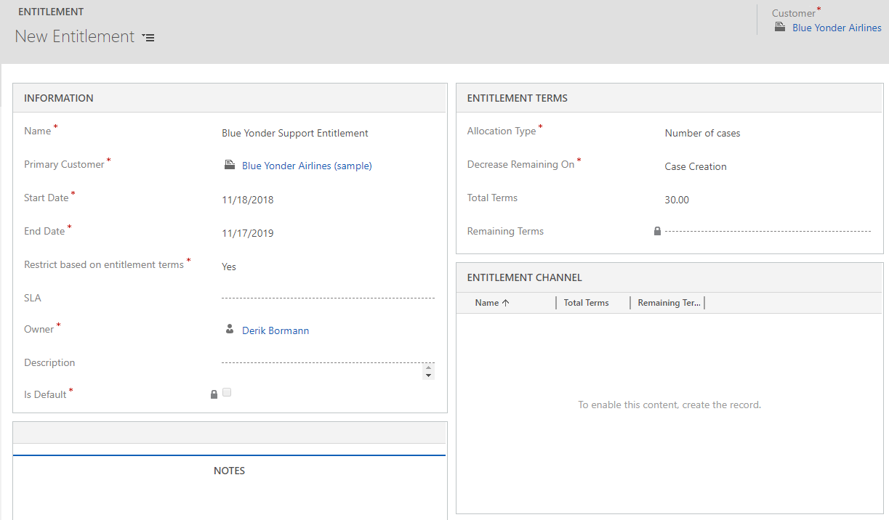
Set Decrease Remaining on to Case Creation
Start on today’s date

Slide 2
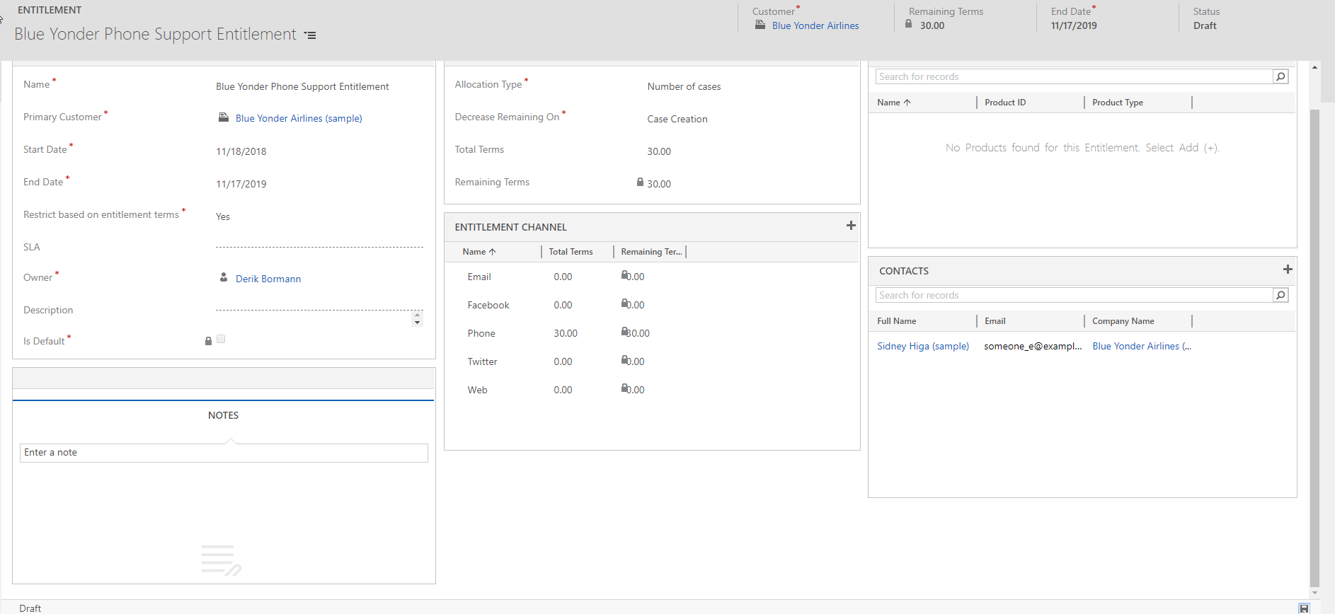
Phone = 30 | All others = 0
Sidney added as contact

Slide 3
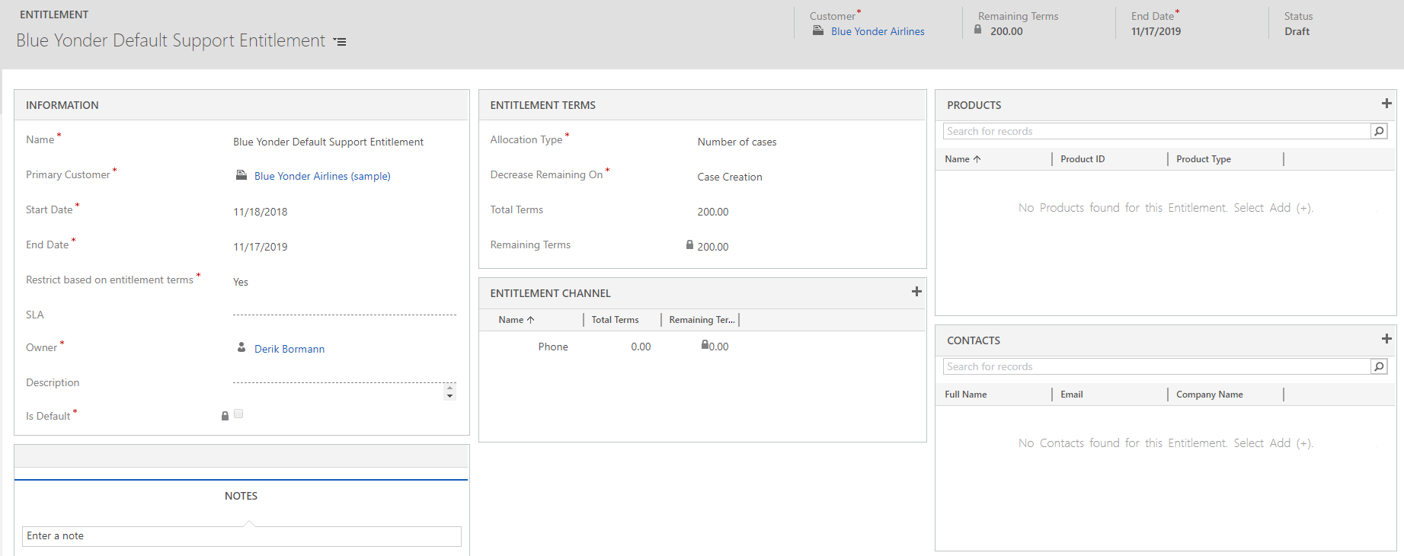
Only phone channel defined
Set to 0

Slide 4
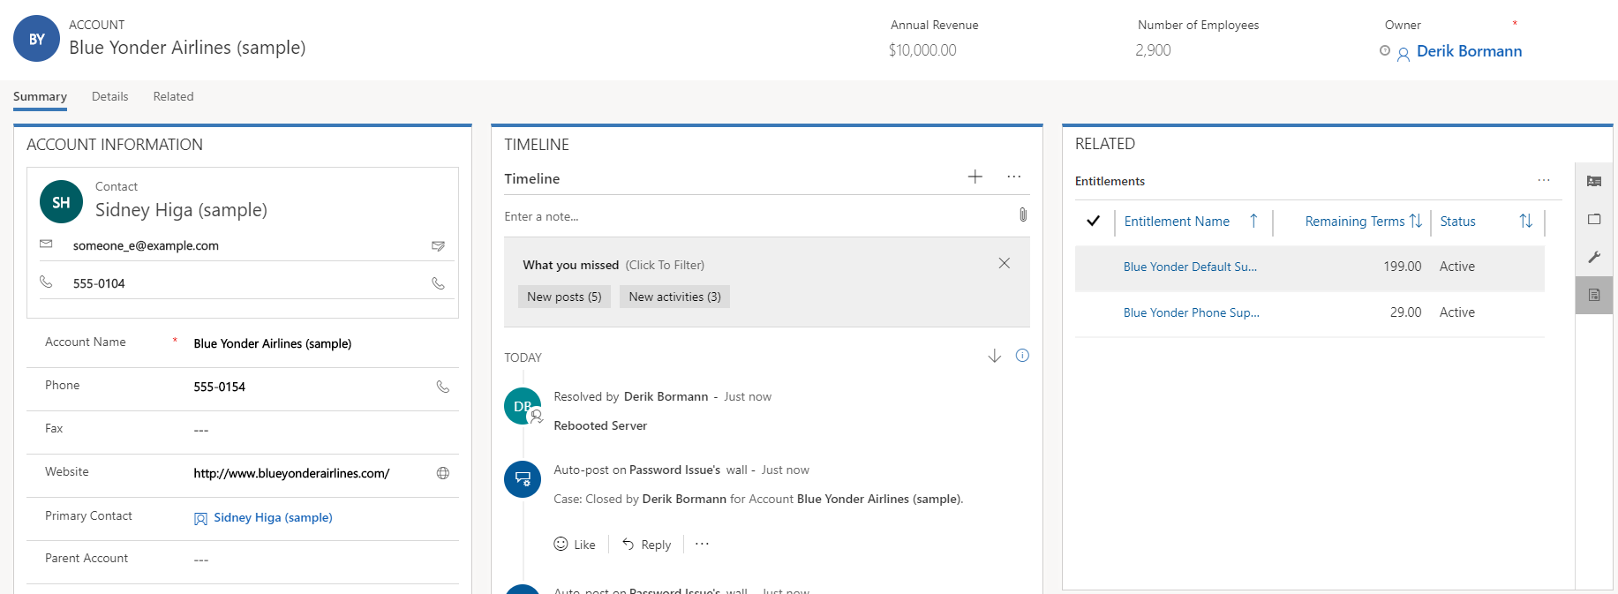
Both entitlements reduced by 1
Switches to display entitlement

